Slide 1
Digital Program
Core Leadership Team
Initial Kickoff Workshop
November 18, 2019

Slide 2
AGENDA
Team Introductions
Program Focus / Update
CWB Program Team Logistics
Program Governance / Communications Plan / SharePoint
Implementation / Delivery Methodology and Tools
Training Needs
Environments
Testing Strategy
Architecture / Non-Functional Req / Integration

Slide 3
The key goal of this program is to implement a digital Account Opening processes and be a disrupter in offering unique Online Banking products and services for Personal, Small Business, and Corporate clients.
The program governance defines the framework that will be established to effectively deliver the scope and enable the Digital Program benefits.

Slide 4



Strategic Partners
Partners are critical to the successful delivery of the Digital Program
Temenos
Digital Online & Mobile Apps
Onboarding
Personal Banking
Digital SME Platform
Commercial/Corp Banking
Bits & Glass
Mulesoft APIs
Onboarding
T24
Wave
Payments (C1, WU etc.)
Third Party Partners
Thirdstream
KYC/AML
Equifax
Trans Union
Enstream
Fraud
Watchlist
Business Registries

Slide 5


Proposed Architecture for Partner Services
Temenos Infinity:
Lead partner for staged implementation of all client facing online and mobile services, branch access, API Integration to Mulesoft
New to Bank
unsecured
Mobile
secured
Internet
secured
Call Centre
Branch
Agent
Chat-bot
API
Journey Manager
User Journeys (New-to-Bank & Existing Customers)
Temenos UXP & CMS
User Agents (Bank Staff & Customers)
API layer
Bits & Glass:
Will lead develop and testing for Mulesoft API services, integrating to Infinity, T24, Payment systems, Wave, Thirdstream & 3rd party partners
Single Customer View - CRM
Customer Profitability
Marketing
Servicing
Watchlist
Real-time Engagement
Engagement Decision Engine
Account
Aggregation
Money Mgmt/PFM.
Predictive Analytics
KYC
Sales
Marketing Catalogue
Alerts &
Notifications
Payment Order
Onboarding
Origination
Journey/
Clickstream Analytics
AML
Workflow
Contact log
Fraud
Embedded Analytics
Thirdstream
Responsible to provide services that will complete non face to face validation for both personal and business customers
Document Management
Secure Messaging
Decisioning Rules
Business Support
Risk &
Compliance
User
Management
Consent
Reporting Dashboard
Document
Output
Monitoring & Logging
Holdings
Analytics &
Reporting
API layer
Core banking engine [T24 R12]

Slide 6
Digital / Technology Roadmap
Draft in Progress
F19
F20
F21
F22
F23
New Digital Capabilities
Personal / Motive DAO
Motive Lending
SB Sales & Onboarding Platform (DAO, Lending, Value Add)
Small (<$1MM)
Medium ($1-3MM)
Digital Banking Upgrade(Personal, SB, Corp)
Large ($3-10MM)
X-Large ($10+MM)
Common UX, Single Sign-on
Branch Channel Improvements
Personal Account Opening
SB/MM Account Opening
CRM (SalesForce)
New Technology and System Upgrades
ESB (Mulesoft)
CAFT Upgrade
T24 Upgrade
WAVE Upgrade

Slide 7
Strategy / Scope Discussion
Digital Account Opening (online then move to in-branch use)
Online Banking Platform (Small Business, Corporate, Personal)
Common UX/Single Sign on
NI-RAPs
a. NIRAP - Motive Digital Account Opening Project (WIP)
b. NIRAP-Small Business
2019
Nov
2019
Today

Slide 8
Program Launch (Targets Milestones)
2020
2021
2020
Apr
Jun
Aug
Oct
Dec
Feb
Apr
Jun
Aug
Oct
2021
Today
Branch - Personal DAO
Nov 22
Branch –
Small Business DAO
Motive
Lending
Nov 30
Motive Digital
Account Opening
(DAO)
Apr 30
Apr 30
Personal
DAO
Jul 31
Sep 30
Personal Digital
Banking Platform
Dec 11
Small Business Banking
Platform (including Small Business DAO)
Corporate Digital Banking Platform
May 28

Slide 9
Draft Critical Path – Digital Account Opening
Motive - Friends & Family Launch
Apr 20
Personal - Friends and Family Launch
Motive - Full Launch
Jun 15
Personal - Full Launch
2019
2020
May 4
Jul 20
2019
Nov
Dec
Jan
Feb
Mar
Apr
May
Jun
Jul
Aug
2020
Today
34 days
Nov 18 - Jan 2
Scope Analysis
35 days
Dec 1 - Jan 17
Design/Build/Unit Test
70 days
Dec 15 - Mar 20
System Integration Testing (All Partners - full end to end)
20 days
Mar 23 - Apr 17
User Acceptance Testing
143 days
Jan 2 - Jul 20
Marketing - Motive & Personal
175 days
Dec 2 - Jul 31
People First - Business Readiness and Support Structures
84 days
Apr 14 - Aug 7
Stabilization and Closure

Slide 10
Draft Critical Path – Small Business Banking Platform
Friends & Family Launch
Dec 7
Full Launch
2020
2021
Jan 10
2020
Jan
Mar
May
Jul
Sep
Nov
Jan
2021
Today
42 days
Jan 2 - Feb 28
Scope Analysis
115 days
Feb 9 - Jul 17
Design/Build/Unit Test
125 days
Mar 15 - Sep 4
System Integration Testing (All Partners - full end to end)
60 days
Sep 7 - Nov 27
User Acceptance Testing
174 days
Jun 2 - Jan 29
Marketing - Small Business
260 days
Feb 16 - Feb 12
People First - Business Readiness and Support Structures
50 days
Dec 7 - Feb 12
Stabilization and Closure

Slide 11
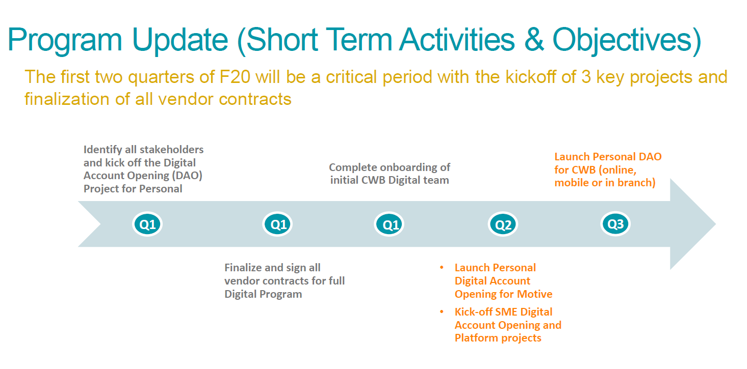

Slide 12
Program Team Logistics
Secured 15 spots on the 24th floor – moves will be discussed/scheduled in the next two weeks.
Looking to secure the 20th 2004 restricted meeting room for Program Team use
Program Conference Bridge will be created
Program SharePoint Site Setup under the PMO Team Page:
  http://sp.cwb.local/projects/pmo2/Digital%20Program/SitePages/Home.aspx
Notes:
Program Management is a method to manage related groups of projects.

Slide 13
Program Governance

Slide 14
Program Governance Framework
Establishing an effective governance framework is critical and will enable success of the program. Governance addresses the following needs:
Executive
Steering Committee
Continuous linkage to enterprise business strategy and direction
Decisions appropriately interpret / align with organizational objectives and principles and they are occurring at the appropriate level
Clear and well-understood decision-making authority and accountability
Effective oversight of and insight into program progress and direction
Executive control over program evolution and outcomes
Program progress, risks and issues are being effectively managed
Direction and Decisions
Options and Analysis
Sponsor Oversight Group
Program Owners

Slide 15
Program Governance - Roles and Responsibilities
Executive Steering Committee (monthly meeting)
Make key program decision; provide oversight and guidance
Establish and review authority levels
Monitor actual spend against budget
Executive Sponsors (monthly meeting)
Ensure alignment between program benefits and CWBFG strategy and resolve conflicting priorities
Remove organizational roadblocks with Program Owners
Ensure organizational support
Program Owners (weekly meeting)
Responsible for Program budget; ensure accurate reporting
Chairs Program Advisory Group
Responsible for Program deliverables, and recommendations on key program decisions
Program Advisory Group (monthly/as required meeting)
Comprised of invited business and operational VP/AVP level leadership as requested
Provides support in helping advise on program decision, strategy , and provide key information in support of program deliverables

Slide 16
Program Governance & Delivery Framework
Executive Steering Committee
Sponsor Oversight
Stephen Murphy (Co-Chair), Darrell Jones (Co-Chair), Chris Fowler, Azfar Karimuddin, Jeff Wright, Christina Mullin, Jason Bond, Matt Evans, Program Manager (Ex Officio)
Jeff Wright
Azfar Karimuddin
Governance
Program Owners
Christina Mullin
Jason Bond
Execution
Program Manager
Program Advisory Group (PAG)
Branch & Department Managers
Functional Experts (SMEs)
UAT Members
Change Champions
Delivery
Enterprise Risk Mgmt
Legal
IS Support
Client Solutions
Operations
OCM
AIRB/ARIB-SO
Risk IT
CRM
Regulatory
Compliance
RDAAR
Due Diligence
Guidance /
Support
Contract Review
Infrastructure /
Security
Info. Mgmt.
Application / QA
Business Analysis
Digital & Alt. Channels
Marketing
Sales Strategy & Effectiveness
Product Development
Banking Ops
Lending Ops
Centralized
Srvcs
Credit Support
Change Impacts
Communications
HR
User Training
Adoption
Engagement

Slide 17
Partner (Vendor) Governance Alignment
CWB
Partners
Sponsor Oversight
Program Owners
Program Manager
Core Program Leads / Team
Executive Steering Committee
Account Executives
Account Managers / VPs / Directors
Project Managers
Project Leads / Teams
Executives

Slide 18
Governance Communications
Program Scheduled Meetings
Weekly Program Owners Meeting: 30 min
Weekly CWB Program Team Meeting: 1 hr
Daily Core Team Stand Ups: 15 min
Weekly Partner Meetings: 30 min
Monthly Program Risk/Dependency Meetings: 1 hr
Monthly Partner Program Risk Meetings: 1 hr
Monthly Sponsor Oversight Meetings: 1 hr
Monthly Executive Steering Committee Meeting: 1 hr
Program Status Reporting
Partner reports – Due Thursday
Program Owner Draft – Sent Friday
Project Owners - Review Monday
Team Distribution – Tuesday Morning
Monthly Sponsor Oversight / Executive Steering Committee Distro – min two days in advance
Note: These are not the team level meetings – still TBD

Slide 19
Implementation / Delivery Methodology + Tools
  CWB Change in Delivery Approach in support of Digital
  Temenos –> User Stories + Jira/Temenos Portal + Temenos Implementation Methodology
  Bits in Glass (BIG) - ?
  ThirdStream - ?
  Training Needs – MuleSoft / Temenos Tools / Jira

Slide 20
Environments
  MuleSoft - Cloud vs. On-premise decision still outstanding
  Cloud to start with, need to validate how far we can take this via BIG envs
  Assessment of what is needed to open up access to MuleSoft env – security needs

Slide 21
Testing Strategy
  User Story - Partner test case/scenario reviews
  SIT - Partners
  Performance - Partners
  UAT - CWB

Slide 22
Architecture / Non-Functional Req. / Integrations
  <review topics and discuss ownership/next steps on each>

Slide 23
Thank you

Slide 24
Key Program Risks
  Project Timeline Delays – key project resourcing onboarding/availability, length of time to complete CWB/vendor procurement processes, vendor resource availability, unexpected vendor delays, limited/no contingency in the schedule.
  Quality of Vendor Delivery – takes more time to stabilize through testing/defect fixes than planned.
  New Vendor Engagement – first time CWB architecture and vendor engagements.
  Delivery Model - ability to move project work fast through matrix/shared resource teams and enhancement processes (vs. dedicated and Delivery teams)
  Agile Program Structure – core/support teams still being defined/sourced with many unknowns to validate.
  Scope – vendor products enable CWB to be a market disruptor.
  Budget – ability to keep to targeted budgets.

Slide 25


Program Governance - Roles and Responsibilities
Ensure organizational support for the program at the Executive level
Make key program decisions and provide program guidance and oversight
Ensure resource availability to support the program deliverables
Monitor and mitigate program risk, including resolution of issues raised
Review and assess change request recommendations on scope, schedule, and budget
Monitor actual expenditures against the approved budget
Establish and review authority levels
Use influence and authority to assist the program in achieving its outcomes
Facilitates benefits enablement through program delivery
Executive Steering Committee
Provide executive oversight and communication of the Program
Ultimately responsible to ensure alignment between the Program benefits and CWBFG strategy and resolve conflicting priorities
Demonstrates sponsorship by active and visible participation
Interacts directly with the Program Owners
Work to remove organizational roadblocks as identified by the Program Owners
Executive Sponsors

Slide 26


Program Governance - Roles and Responsibilities
Overall responsibility for Program budget, ensuring adequate and accurate reporting and reconciliation
Program deliverables, including providing input, review, and making recommendations on key Program decisions and documents
Demonstrate sponsorship through active and visible participation
Is accountable to the Executive Sponsor to share concerns, discuss risks, and ensure constraints are dealt with in a proactive manner
Interacts directly and regularly with the Program Manager and Executive Sponsors
Chairs Program Advisory Group
Program Owners
Providing overall guidance to the program team through development and administration of the Project Management Plan
Responsible for maintaining the established processes and procedures, ensuring processes provide for early identification of delays, emerging issues, and budget slippage
Responsible for tracking completion of key deliverables and project delivery and transition activities in the Stage Gate Checklist
Responsible for the management of internal and external resources, developing different capacity models to support demand, ensuring optimal use of resources to achieve targets
Providing regular communication and weekly Program status updates to Program team, Program Owner/Executive Sponsor, Executive Program Steering Committee and key Stakeholders
Program Manager

Slide 27

Program Governance - Roles and Responsibilities
Group will comprise of invited Business and Operational VP/AVP level leadership, as requested
Provides support in helping advise on program decision requests, strategy, and/or provide key information and materials in support of finalizing program deliverables and/or post sustainment ownership structures
Chaired by the Program Owners
Program Advisory Group

